Slide 1
The Annual Sustainability Conference – 2sd edition Sustainability and Economic & Social Transformation Egypt – Luxor 2-5 March 2022

Slide 2
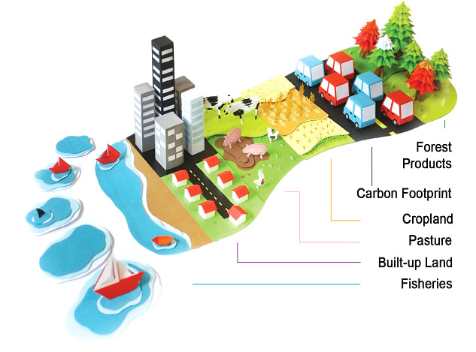

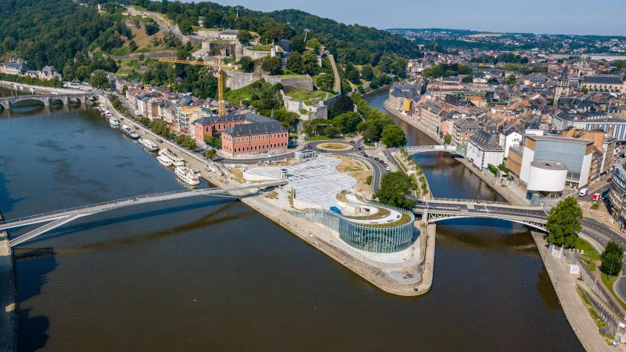

From the small Nile of Namur (La Meuse) - Belgium
Policy | Production & consumption | Classroom

Slide 3
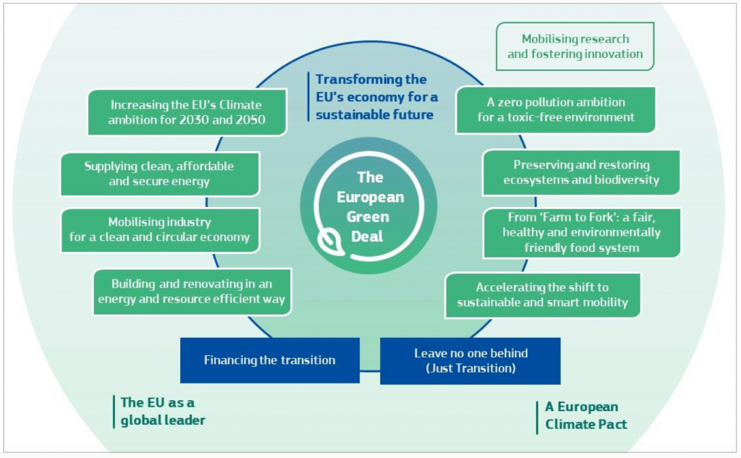
Sustainability: a whole EU approach 2030/2050 (1/3)
EU Global Gateway
Notes:
The European Green Deal is to play an important role in the region's COVID-19 recovery.
The deal aims to cut carbon emissions, achieve economic growth not tied to resource use and ensure no one is left behind.
The "Fit for 55" package of additional policies is expected to be announced on 14 July.
The European Green Deal is about improving the well-being of people. Making Europe climate-neutral and protecting our natural habitat will be good for people, planet and economy. No one will be left behind.

Slide 4








































































Sustainability: a whole EU approach 2030/2050 (2/3)
An integrated agenda building on experience
Corporate Members
National Partner Organisations (NPOs)
PURPOSE
PLAN
CULTURE
COLLABORATION
ADVOCACY

Slide 5
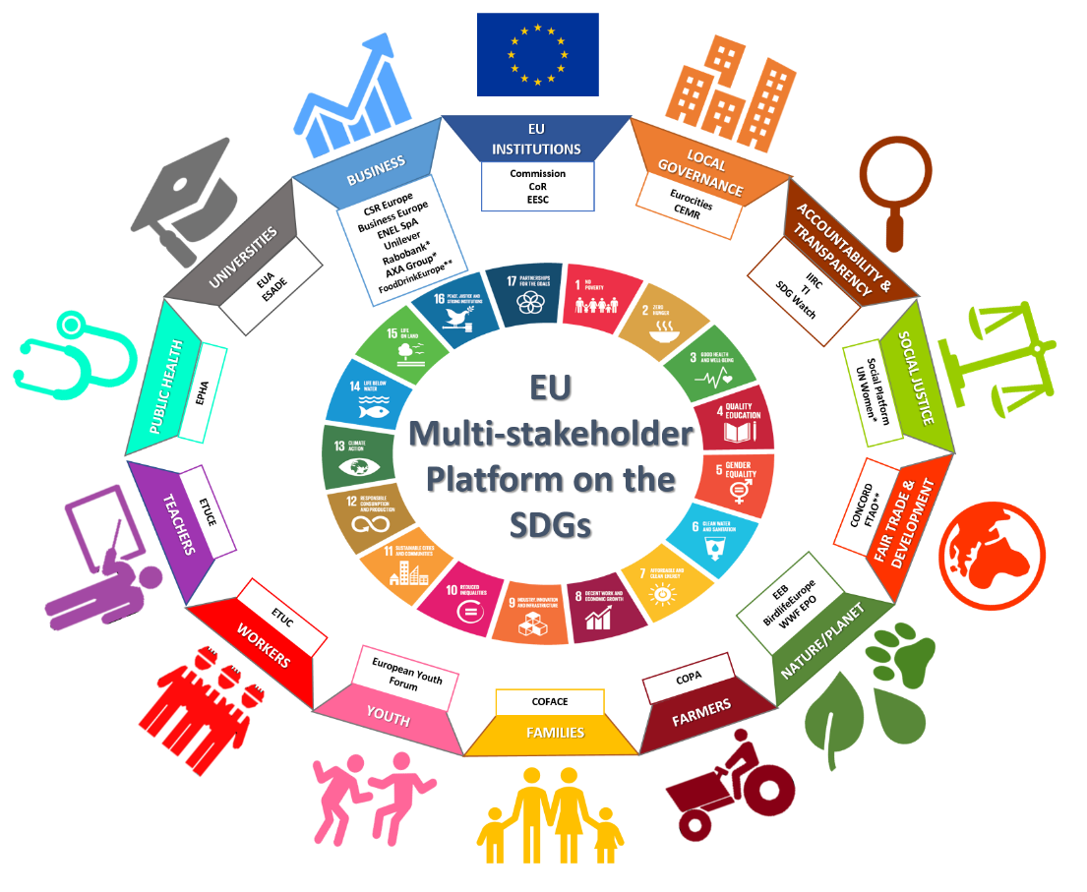
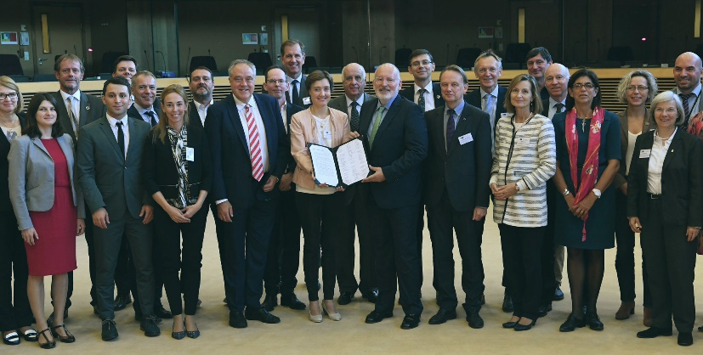

Sustainability: a whole EU approach 2030/2050 (1/3)
Multi-stakeholder platform on SDGs

Slide 6
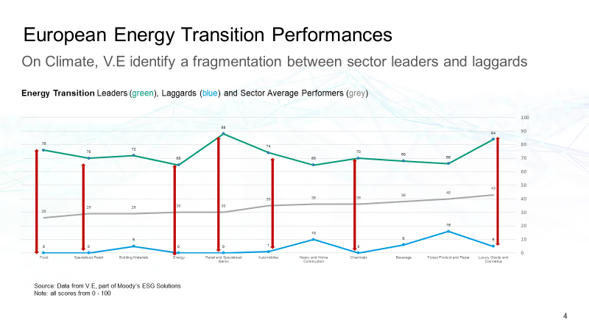
We are not there yet!
The European Sustainable Industry Barometer (1/3)

Slide 7
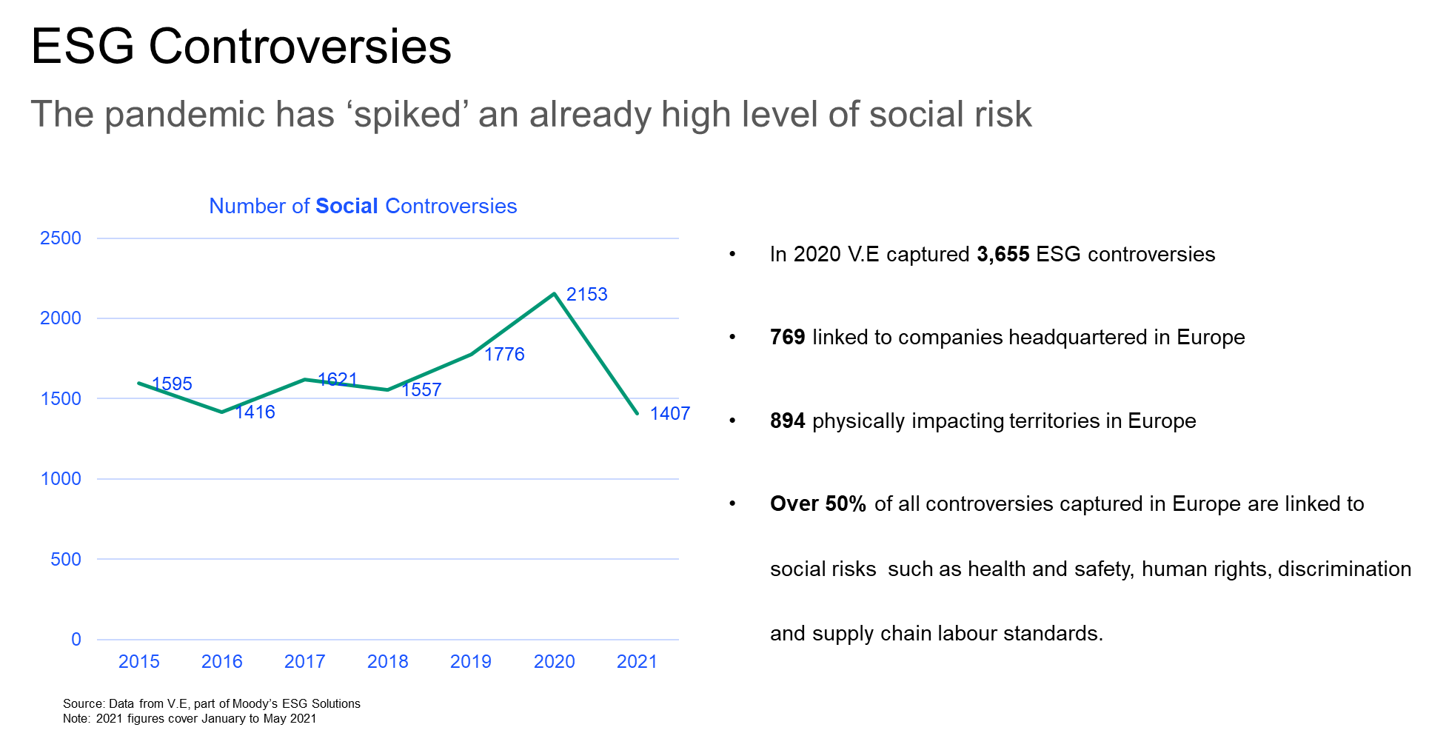
We are not there yet!
The European Sustainable Industry Barometer (2/3)

Slide 8
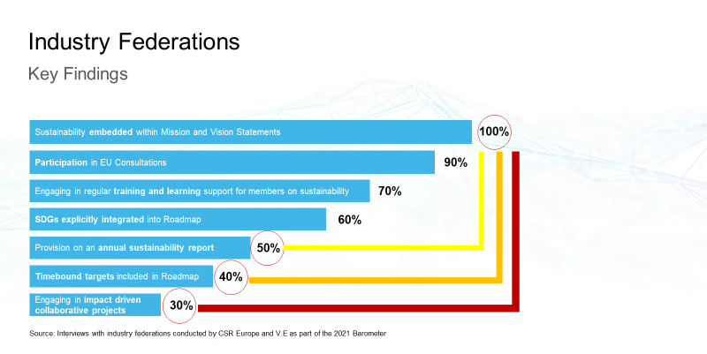
We are not there yet!
The European Sustainable Industry Barometer (3/3)

Slide 9
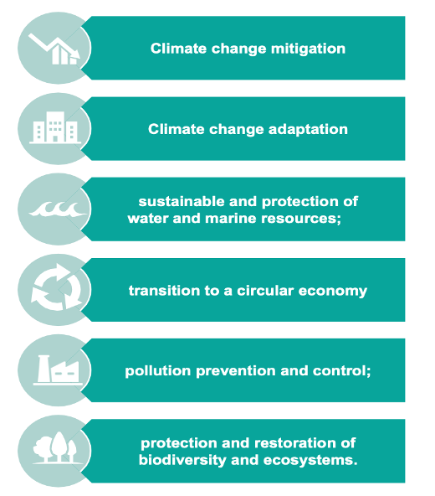
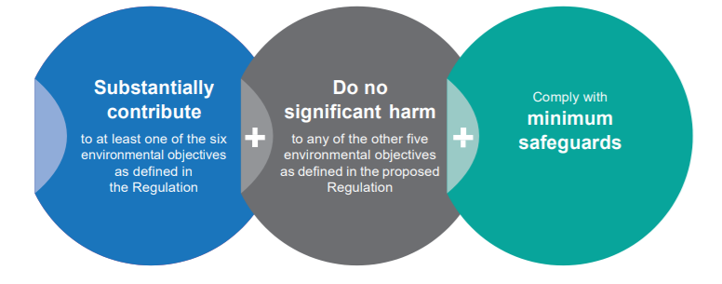
What is keeping businesses busy (1/3)
Unlock investments to support transformation
The taxonomy is set to mobilise the €350 billion of additional investment Europe needed annually to achieve the climate neutrality by 2050.
EU Social Taxonomy

Slide 10
What is keeping businesses busy (1/3)
Unlock investments to support transformation
Proposal published in April 2021
Corporate Sustainability Reporting Directive
Scope
From 11.000 to 50.000 companies
Reporting requirements
Mandatory EU sustainability reporting standards
Format
Included in management reports, in a digital, machine-readable format
Materiality
Double Materiality
Assurance
Required limited assurance
The European Commission has published a proposal for a regulation establishing a European single access point (“ESAP”), a centralised platform allowing access to publicly disclosed information on financial services, capital markets and sustainability. The European Securities and Markets Authority (“ESMA”) is tasked with establishing the ESAP by 31 December 2024.

Slide 11
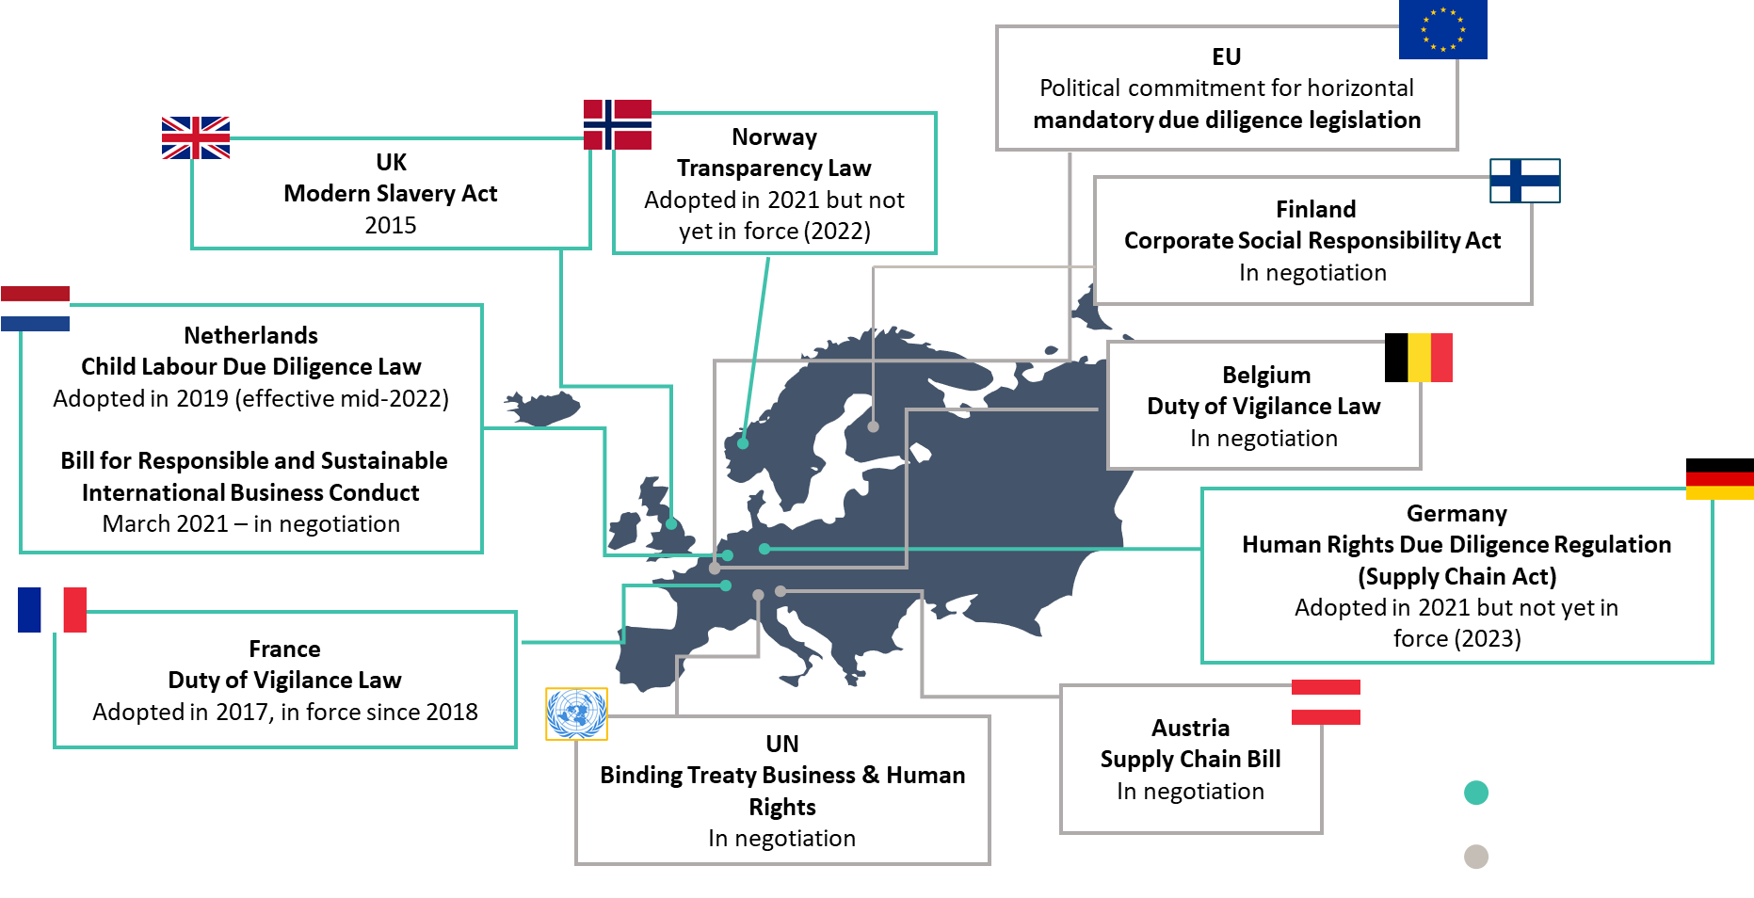
What is keeping businesses busy (2/3)
Due Diligence…
Adopted regulation
Expected regulation

Slide 12
What is keeping businesses busy (2/3)
A Future EU Due Diligence Law
A duty to care…
…towards a duty to collaborate.
Among the actions to be taken, the proposal suggests:
The development and implementation of a prevention action plan, with reasonable and defined timelines for action and qualitative and quantitative indicators for measuring improvement
Contractual assurances from a business partner with whom it has a direct business relationship
Make necessary investments to comply
Support for SMEs with which the company has an established business relationship
Collaboration with other entities to increase the company’s ability to bring the adverse impact to an end

Slide 13
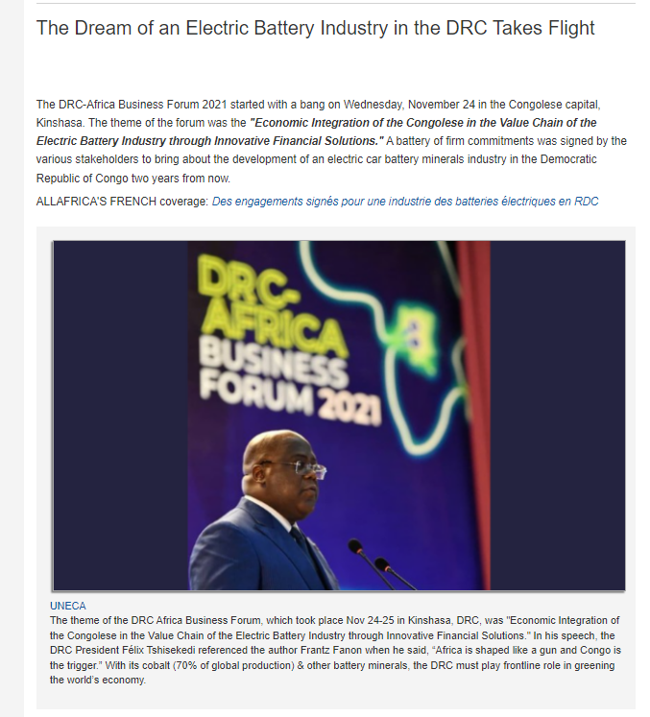
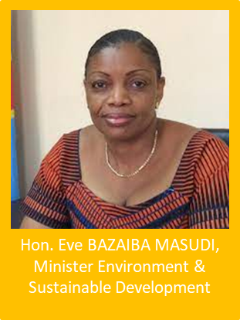
What is keeping businesses busy (2/3)
Due Diligence…
Increase wealth, create jobs and new skills for young people through sustainable value chains linked to mining resources used in electric batteries (cobalt, copper, lithium, manganese, nickel, graphite), with the objective of supporting the Democratic Republic of the Congo to transform its natural resources into sustainable prosperity for all.
CSR Europe received an invitation from Hon. Ève Bazaiba Masudi, Deputy Prime Minister and Minister of the Environment and Sustainable Development of DRC, to host a dialogue with CSR Europe’s members and partners in the automotive sector.

Slide 14
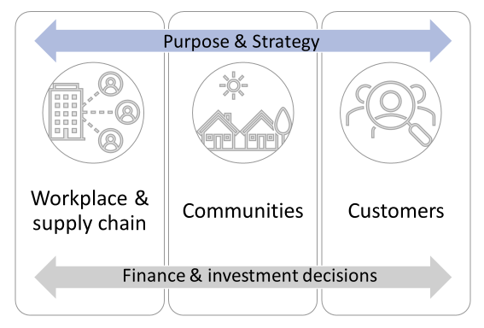



What is keeping businesses busy (3/3)
More equity on equal ambitions: a fair transition towards climate neutrality
Cop 26 Declaration
For a Just Transition

Slide 15

Let’s cooperate!

Slide 16




Thanks for your attention!
Get in touch:
Jan Noterdaeme
jn@csreurope.org

